Slide 1
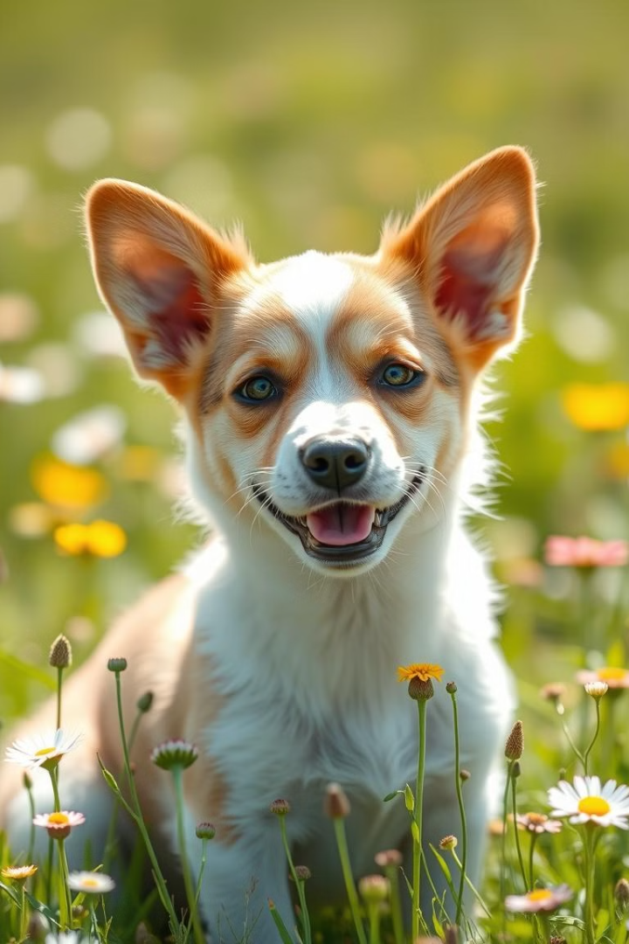


Dog Recognition System in Python
The Dog shelter - Fifth leg (penktakoja.lt) is a project that hopes to spread warmth and companionship to homeless dogs and cats. On average, this dog shelter takes in about 800 dogs of various ages and breeds per year. About 600 hundred individuals are donated or adopted by dog lovers. The rest are under the care of shelter workers.
by Virgilijus Sakalauskas and Dalia Kriksciuniene

Slide 2
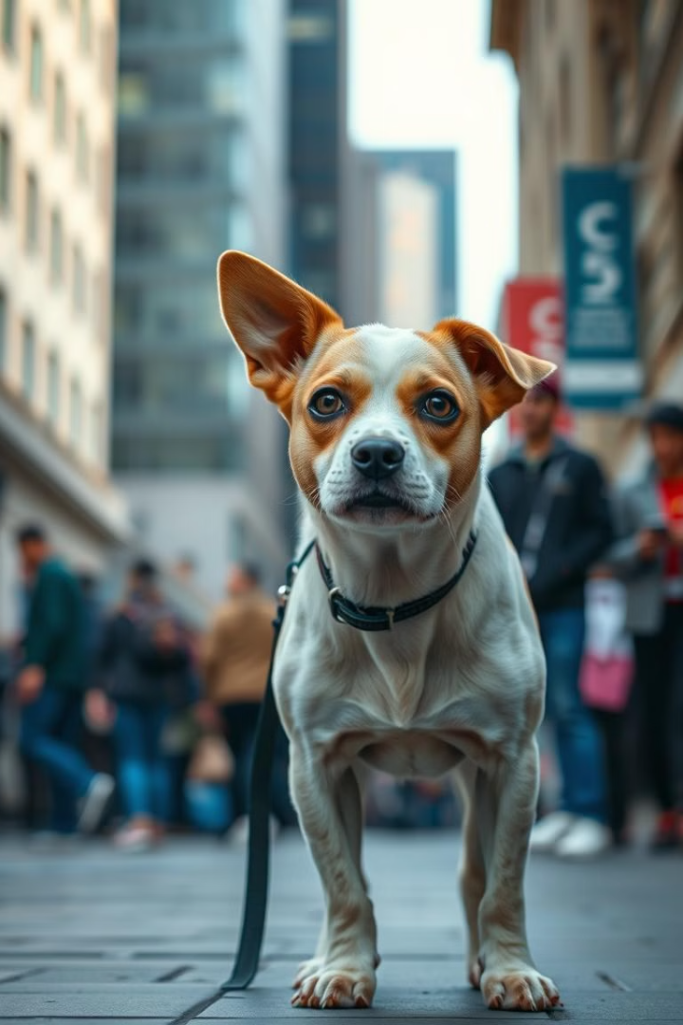
Dog Recognition System: Purpose
The purpose of this project is to take care of homeless or lost dogs who may have been in the dog shelter "Pekta koja" and are photographed and registered there. The idea of the project is to try to identify a lost dog based on a database of dog photos in “Penkta koja” shelter.
Goal
To identify a lost dog based on a database of dog photos.
Method
Leverage computer vision and machine learning to create a model that can compare a new dog's photo with the photos in the existing database and recognize the dog.

Slide 3
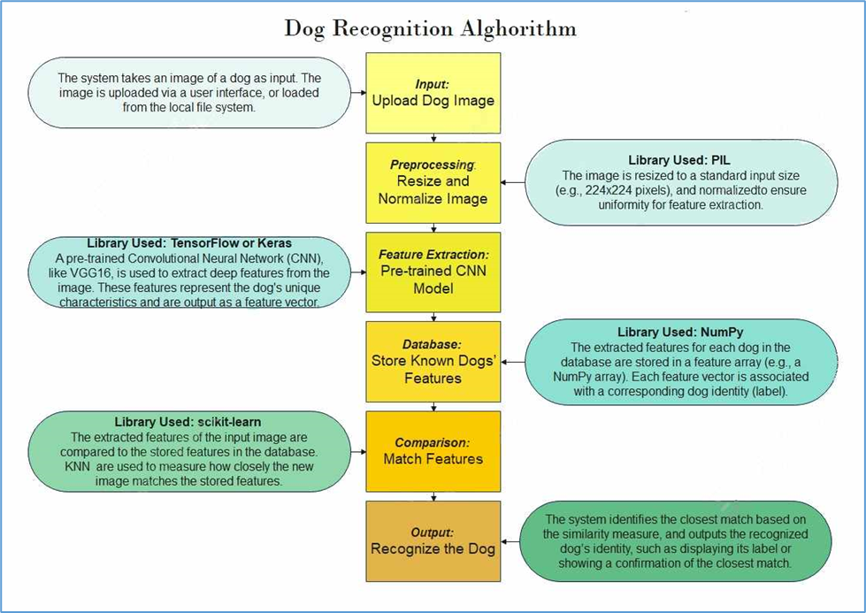
Implementation

Slide 4
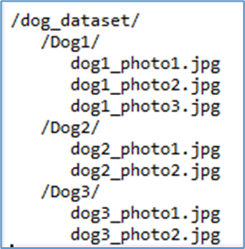
Organizing Dog Photos
We propose to set up a folder structure where each dog has its own labeled folder - create a root folder, and inside it, create subfolders for each dog. Each subfolder should contain multiple images of that specific dog.
Root Folder
Subfolders
Contains subfolders for each dog.
Each subfolder represents a specific dog and contains multiple images of that dog.

Slide 5
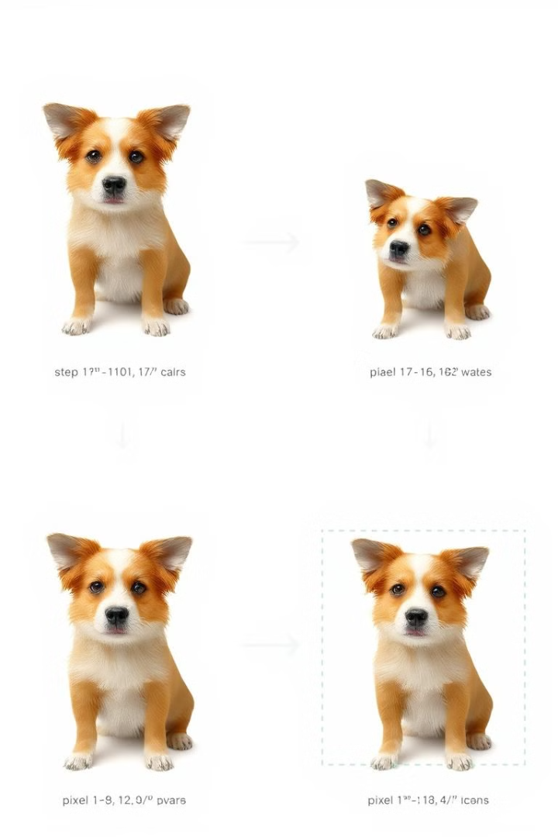
Preprocessing
In the Preprocessing step, resizing and normalizing the image are crucial operations to prepare the image for input into a machine learning model (e.g., a Convolutional Neural Network like VGG16). These steps ensure that all images fed into the model have a consistent format and data range, which improves the model's performance and reliability. The resizing and normalizing the images we perform by Pillow (PIL) library.
1
Resizing
Dog images usually vary in size. As the learning models like VGG16, ResNet, or MobileNet expect input images to be of a fixed size (e.g., 224x224 pixels for VGG16) we need to resize original images.
2
Normalizing
Pixel values in an image typically range from 0 to 255 (for 8-bit images). Different images can have widely different pixel intensity distributions. Normalization scales these values to a consistent range, often between 0 and 1 or around a zero-centered value, making it easier for the model to interpret the image data.

Slide 6
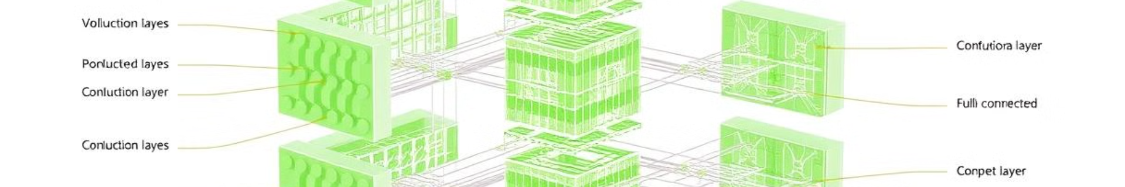



Feature Extraction
Feature extraction is the process of converting an image into a set of numerical values (a feature vector) that represent the most important information about the image. The neural network focuses on important patterns, like edges, textures, shapes and help identify key characteristics of the dog, such as the shape of its ears, face structure, fur patterns, and more.
We use a pre-trained CNN like VGG16 that has already been trained on a large dataset like ImageNet, which contains millions of images across thousands of categories. These pre-trained models have learned to extract general features from images that can be reused for specific tasks like dog recognition.
A pre-trained CNN consists of multiple layers, each responsible for extracting different levels of features:
Lower Layers
Middle Layers
Higher Layers
Detect simple patterns, like edges, corners, and textures.
Detect more complex patterns, like shapes and parts of objects (e.g., dog ears, eyes).
Detect entire objects or very specific patterns, which are helpful for classification.

Slide 7
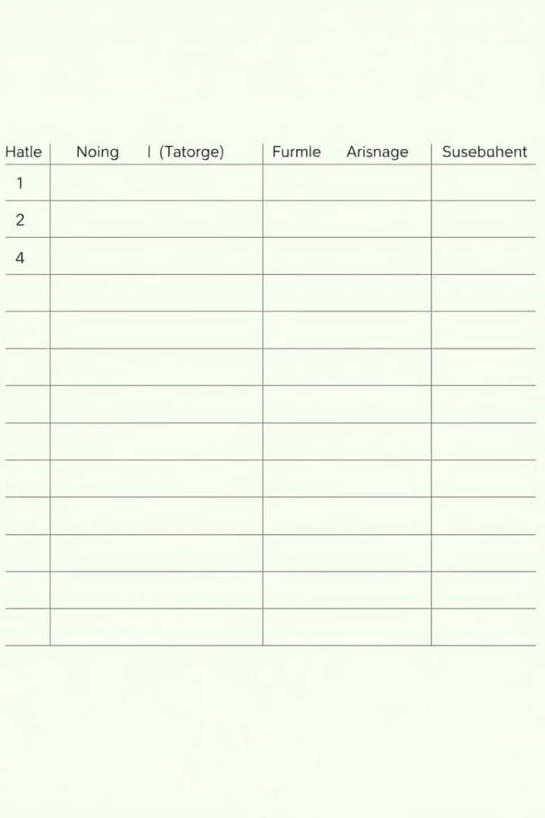
Database
A feature vector is a set of numerical values vector that captures the important traits of an image, such as patterns, textures, and shapes. These feature vectors are generated by the CNN model during the feature extraction step and serve as a compressed, abstract representation of the dog.
For example, after extracting features using VGG16, a feature vector for a dog image might look like this:
Dog ID
Feature Vector
Label
Dog1
[0.12, 0.34, 0.56, ..., 0.91]
Labrador Retriever
Dog2
[0.21, 0.45, 0.67, ..., 0.89]
Golden Retriever
We store these feature vectors and labels using NumPy library in a simple format like a NumPy array database where each row corresponds to a different dog. Alongside the features, you also keep a list of dog labels.

Slide 8




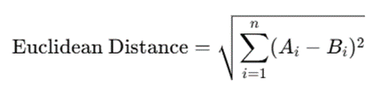
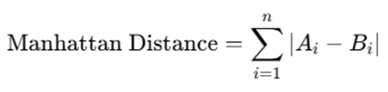
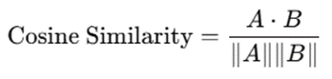
Comparison
Once the database is set up, we utilize scikit-learn library for algorithms like K-Nearest Neighbors (KNN) to compare the input dog's feature vector with all the stored feature vectors in the database. The algorithm calculates the similarity between the input vector and each stored vector, and the most similar one is identified as the matching dog.
In the K-Nearest Neighbors (KNN) algorithm, you don't rely on just one closest match. Instead, the algorithm considers the K closest matches to make a decision. Here are the most popular measures:
Euclidean Distance
Manhattan Distance
Cosine Similarity
The straight-line distance between two vectors in the feature space.
The sum of the absolute differences between coordinates of the vectors.
The cosine of the angle between two vectors, focusing on their orientation in the space.

Slide 9
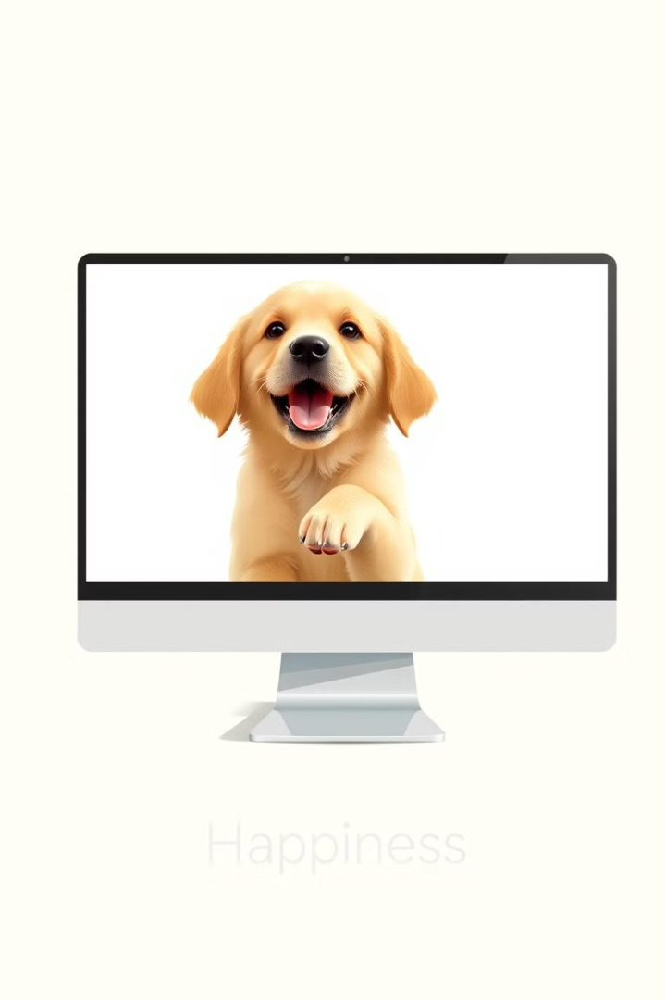
Output
The Recognize the Dog step is the final part of the dog recognition system using the K-Nearest Neighbors (KNN) algorithm. In this step, the system determines which known dog is the best match for the new dog image and provides that as the output.
1
Match
The system determines which known dog is the best match for the new dog image and provides that as the output.
2
Unknown Dog
If no dog’s distance is below the threshold (in our case 500), the system reports that the dog is unknown.

Slide 10
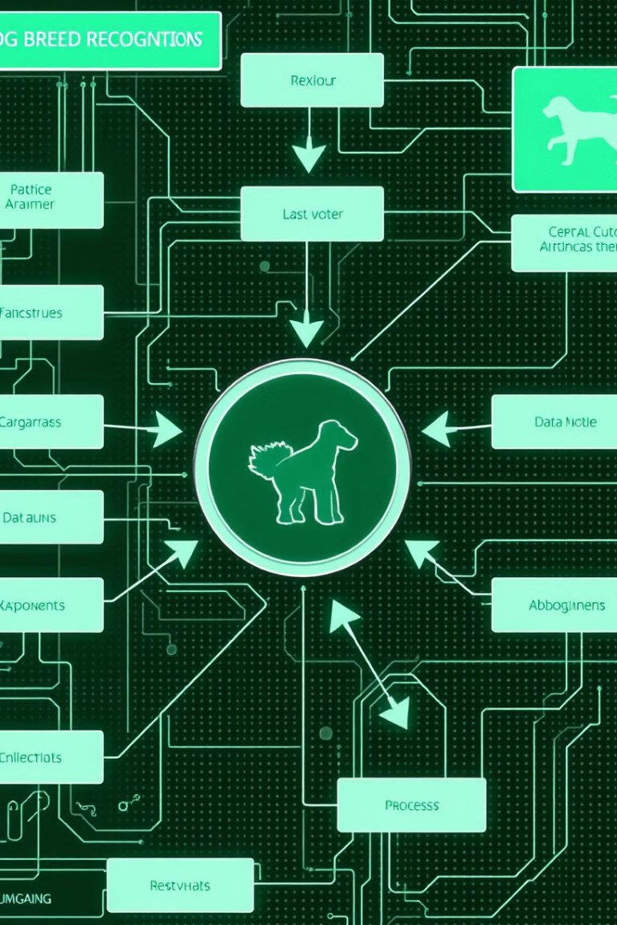
Strengths and Improvements
The implemented dog recognition system is a strong foundation for recognizing dogs based on image similarity. By combining deep feature extraction with KNN and an intuitive graphical interface, it provides a balance between accuracy and simplicity.
1
Strengths
Accuracy and Robustness, Simplicity with KNN, Extensibility, Unknown Dog Detection.
2
Improvements
Fine-tuning the Threshold, Data Augmentation, Handling Larger Databases, Improving Recognition with Fine-Tuning, Real-Time Recognition, GUI Enhancements.

Slide 11
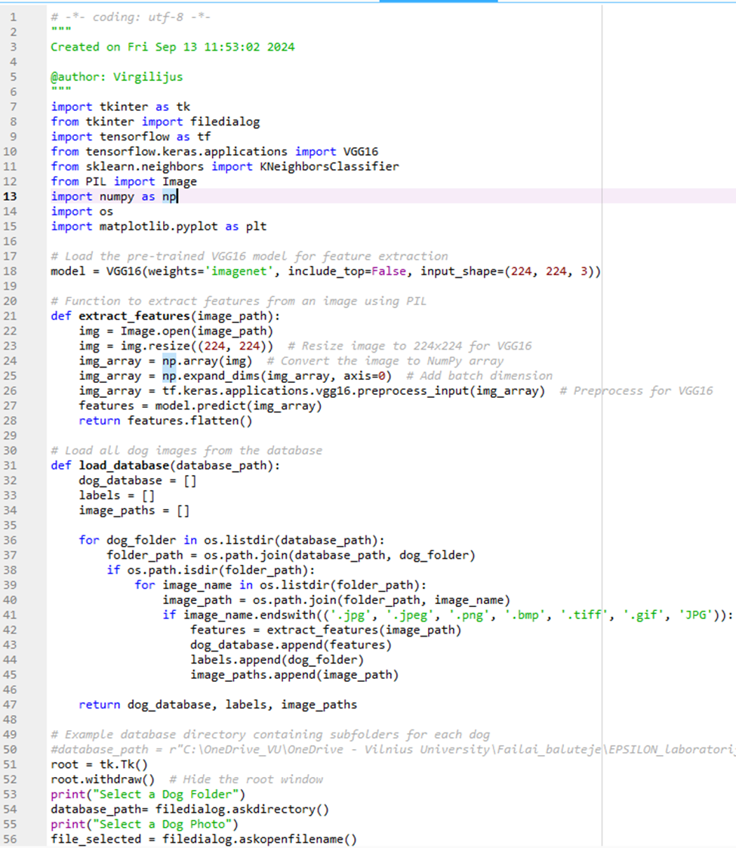
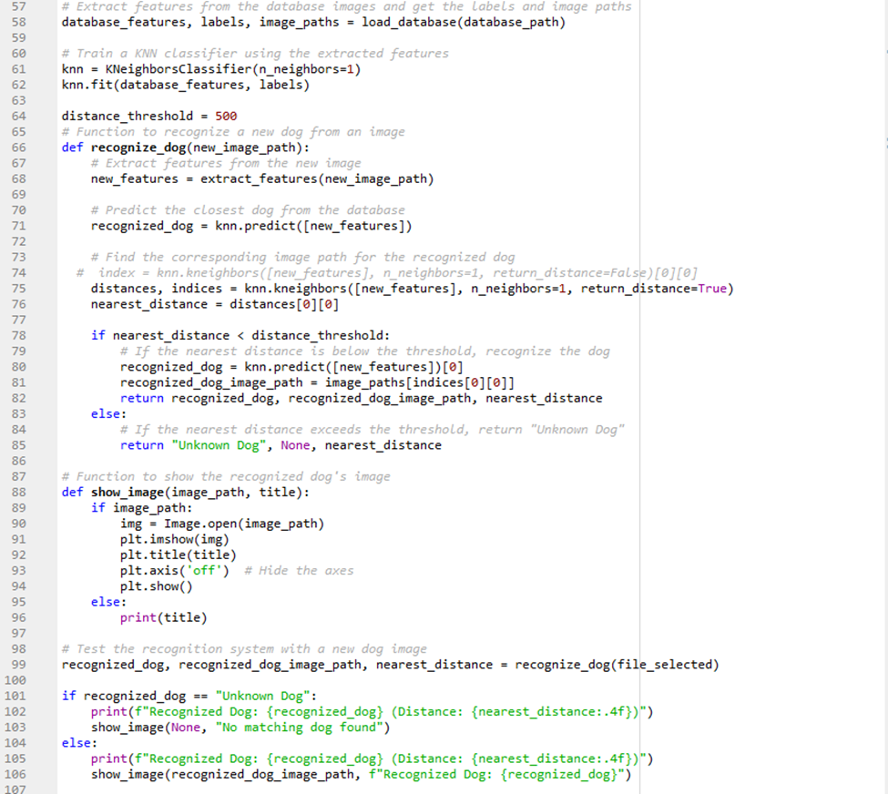
Python program

Slide 12

